Slide 1
Online Examination System
Final Review

Slide 2
Team Member
RA2011003011334 RISHABH SINGH SAHIL
RA2011003011346 NIKHIL KAR
RA2011003011341 ABHISHEK VERMA

Slide 3
ABSTRACT
Online examination systems are becoming increasingly popular as more educational institutions adopt remote learning models. This system provides an effective way for students to take exams securely and conveniently without the need to travel to a physical location. The online examination system is a web-based application that enables students to take tests from any location using a computer, tablet, or mobile device with an internet connection. It has features such as randomizing questions and answers, time limits, and anti-cheating measures to ensure fairness and accuracy. The system also allows instructors to create, manage, and grade exams easily and efficiently. This abstract provides a brief overview of the features and benefits of an online examination system.

Slide 4
INTRODUCTION
The traditional paper-based examination system has various limitations, such as logistical issues, manual grading, and limited question banks. These limitations lead to inefficiencies, inaccuracies, and inconsistencies in the examination process. Furthermore, the COVID-19 pandemic has highlighted the need for remote examination systems to enable students to take exams from home. Therefore, there is a need for an online examination system that addresses the shortcomings of the traditional paper-based exam system and provides a more efficient, secure, and convenient way of conducting exams. This project aims to develop an innovative online examination system that overcomes the limitations of traditional methods and provides an engaging, reliable, and accessible examination experience for students and administrators.
Additionally, the current educational landscape demands a system that provides more personalized learning experiences. The one-size-fits-all approach of the traditional paper-based examination system fails to cater to the unique needs and abilities of individual students. The online examination system addresses this problem by incorporating adaptive testing, which tailors the exam questions to the student's knowledge level. This personalized approach to testing ensures that students are challenged appropriately and can learn at their own pace, leading to better learning outcomes.

Slide 5
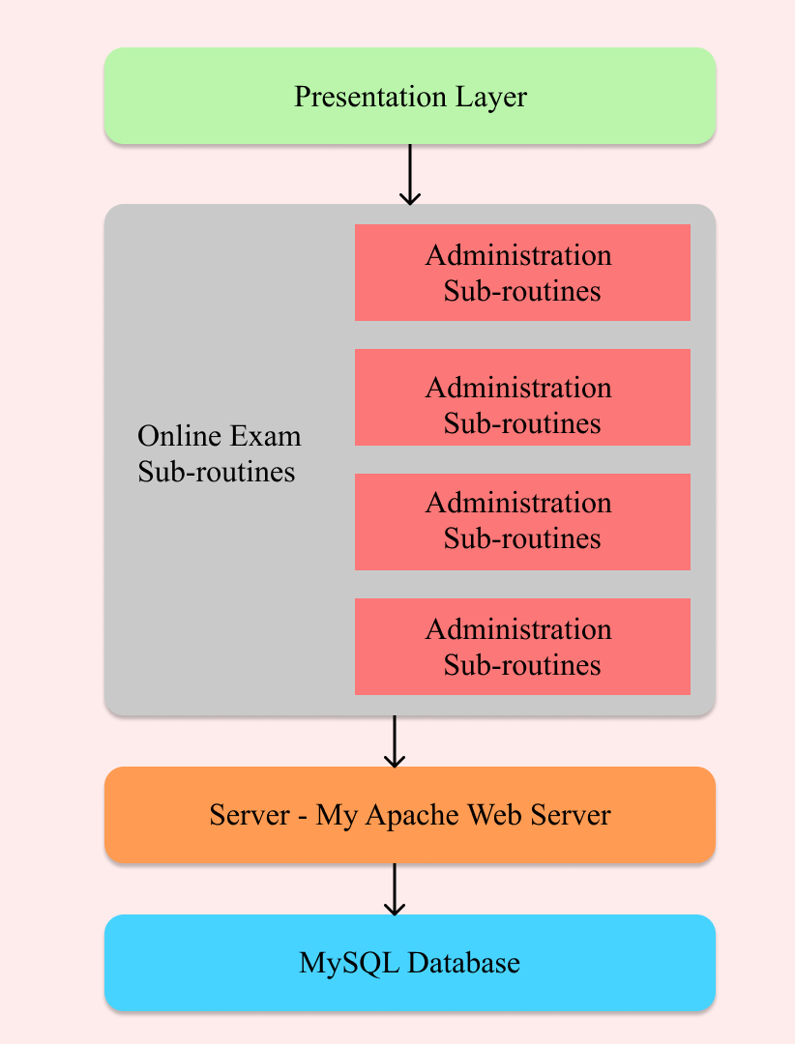
Architecture Diagram

Slide 6
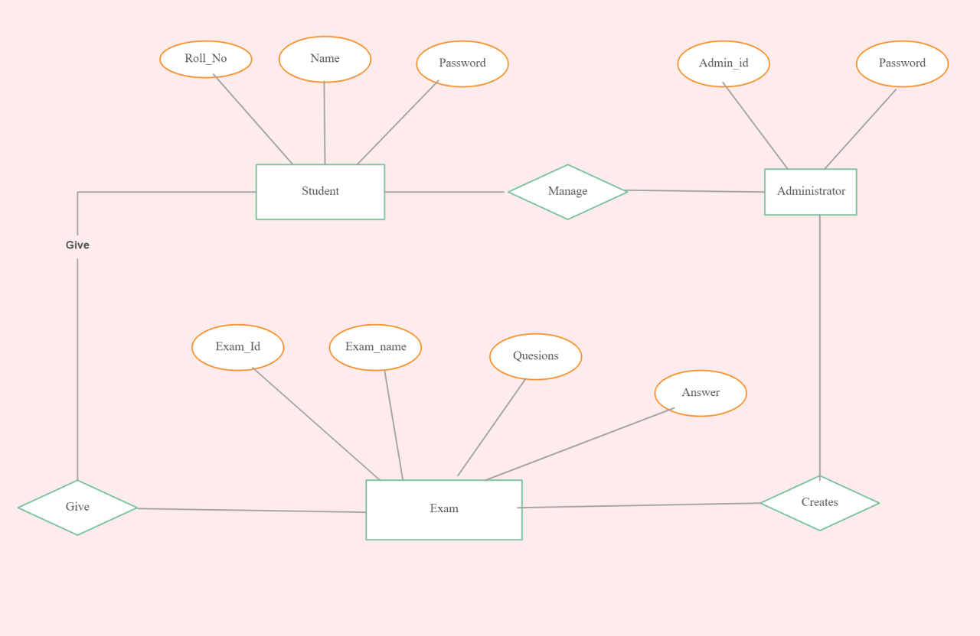
ER Diagram

Slide 7
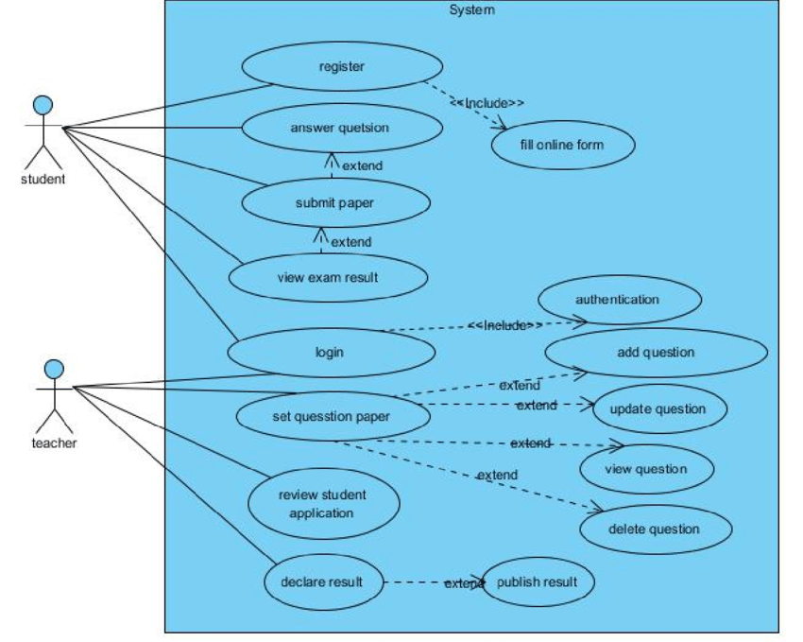
Use-Case Diagram

Slide 8
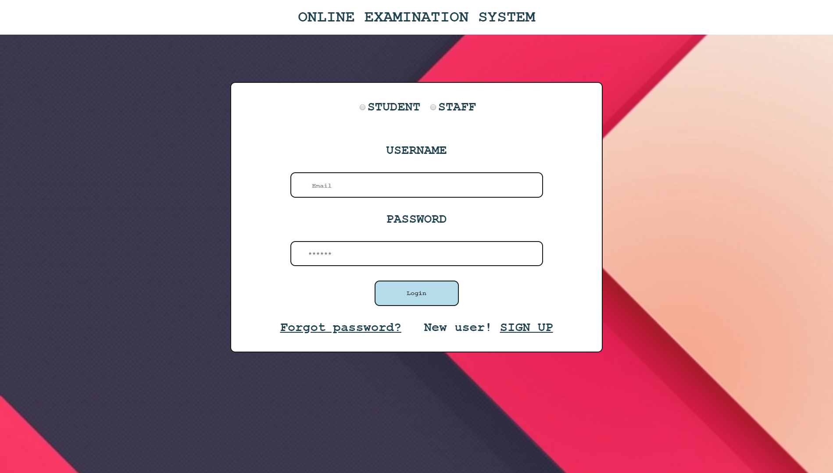
Frontend (UI)

Slide 9
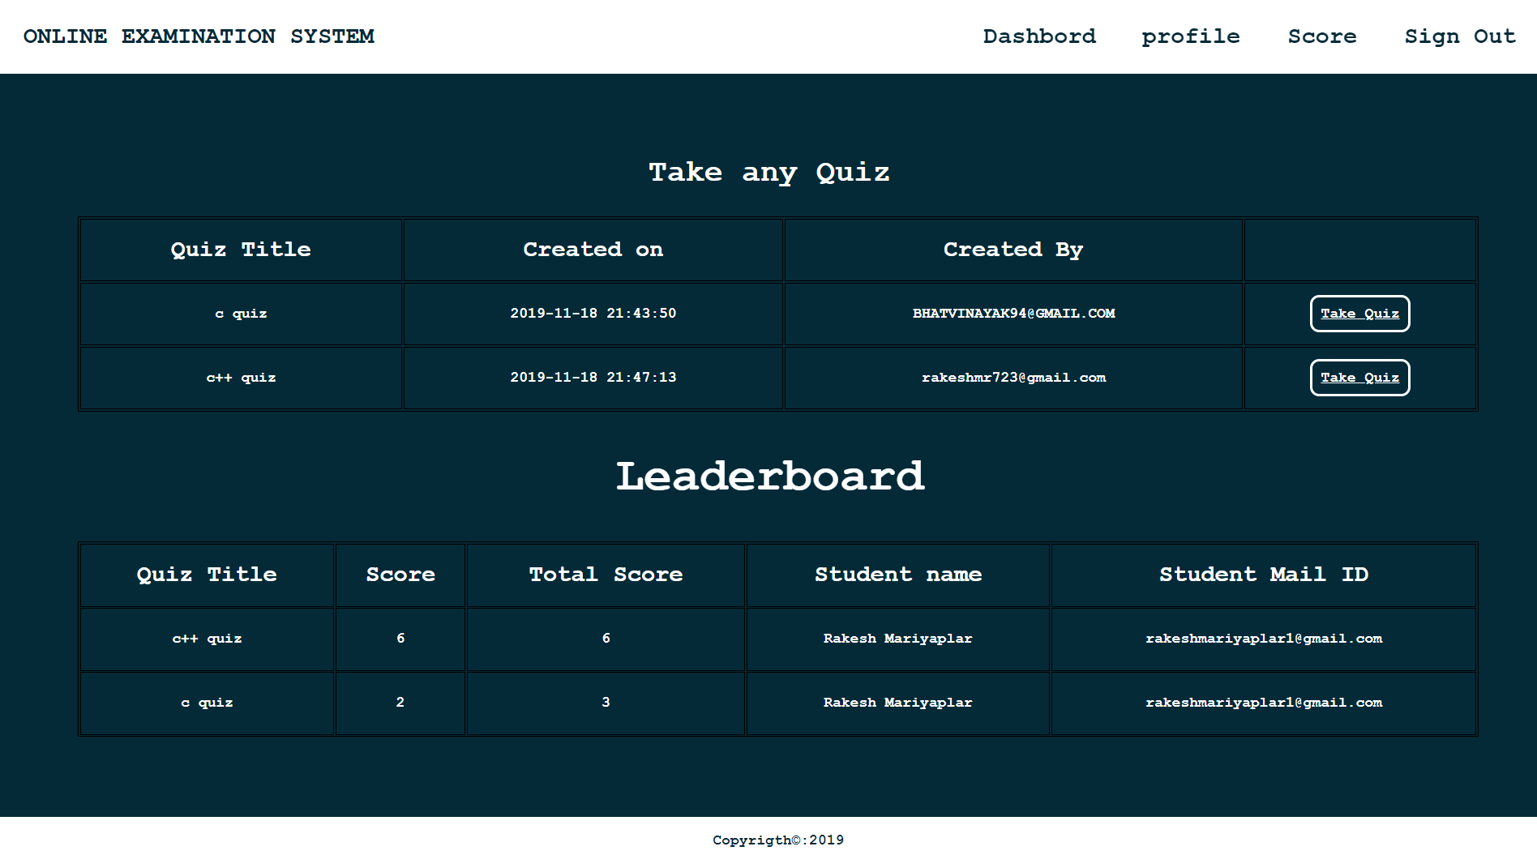

Slide 11
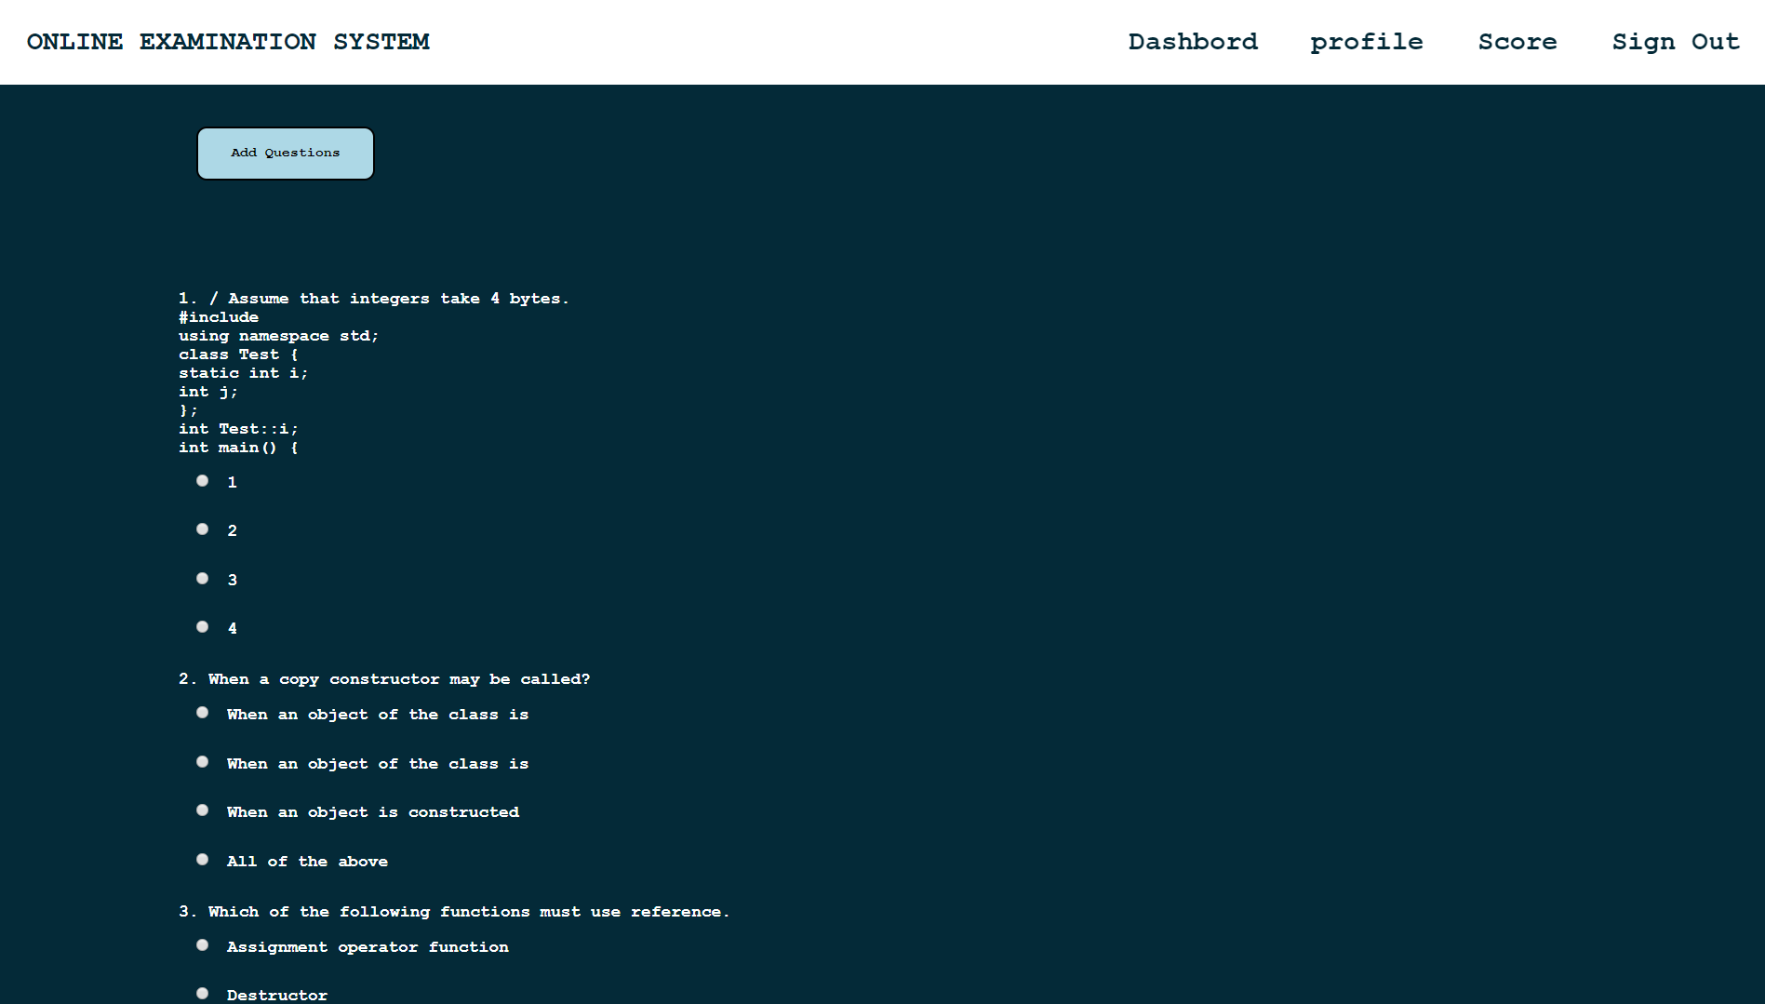

Slide 12
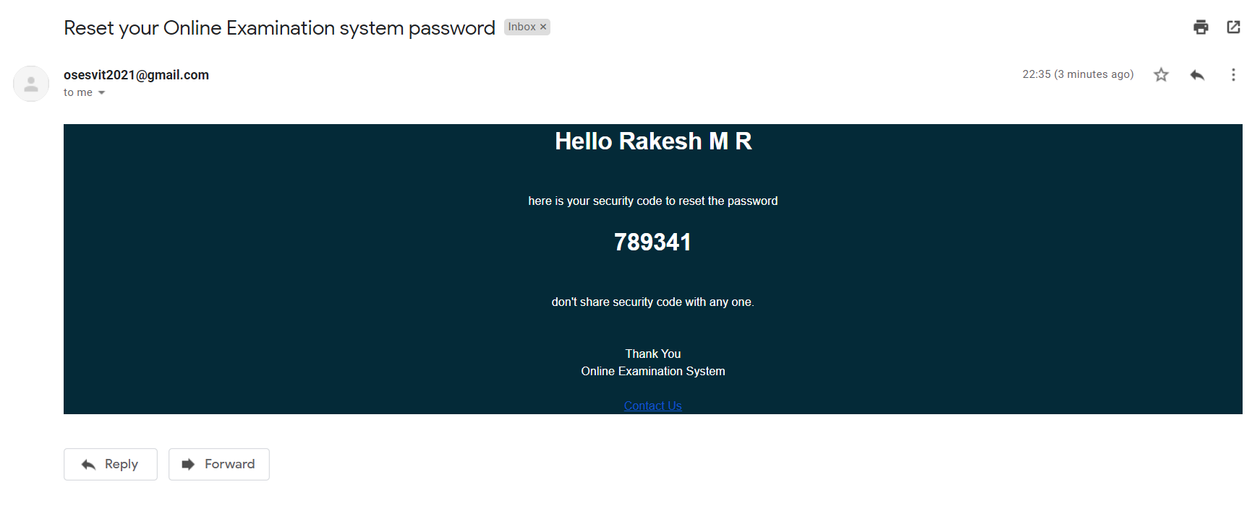

Slide 13
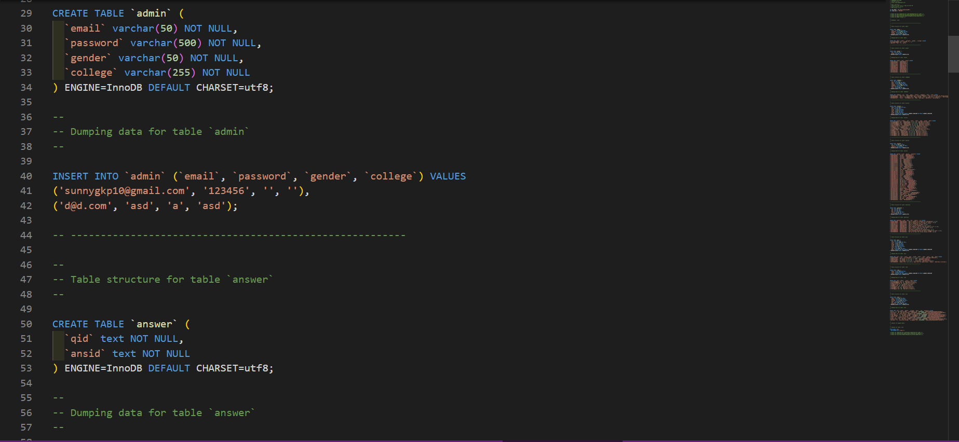
Backend Database

Slide 14
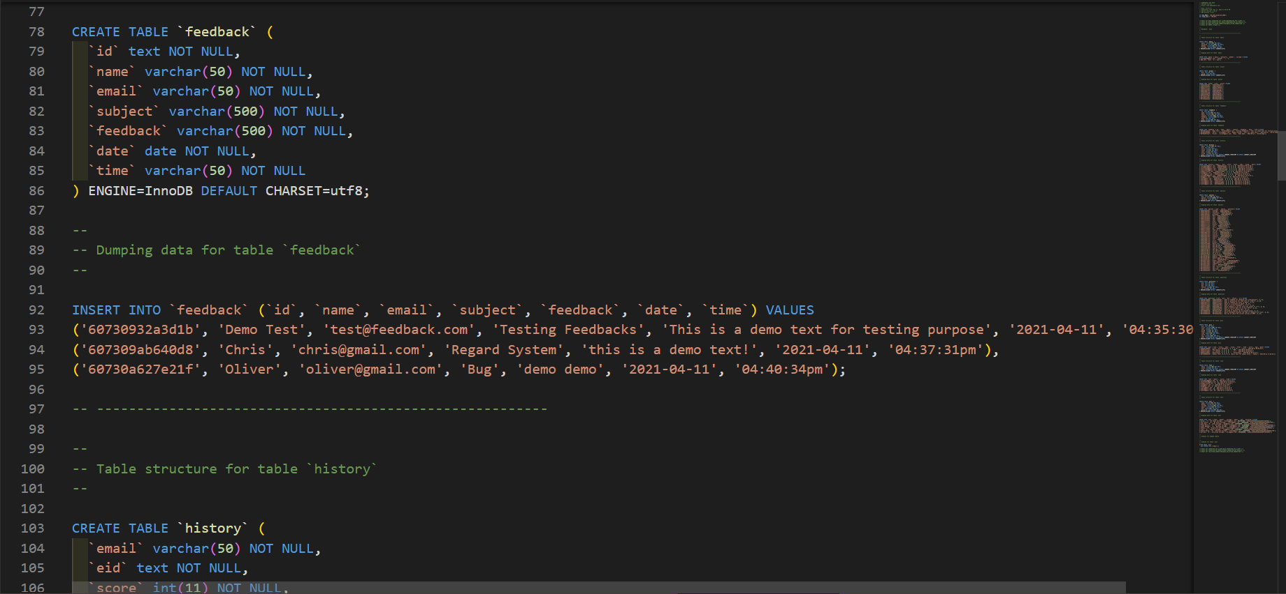

Slide 15
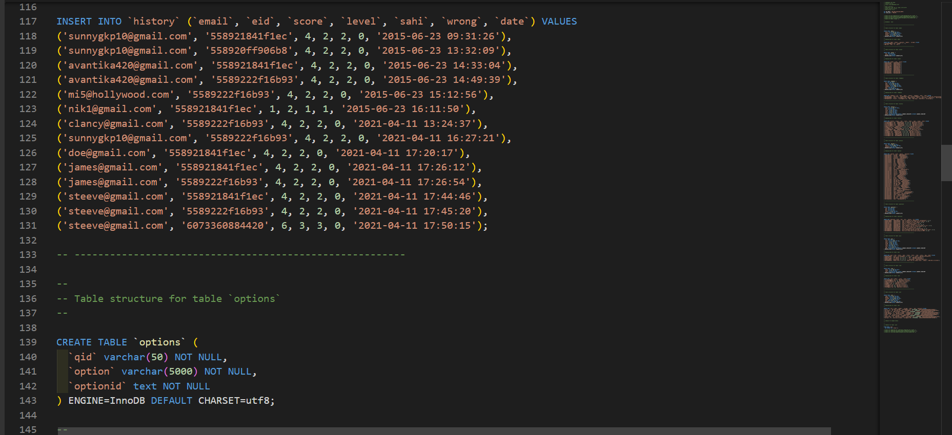

Slide 16
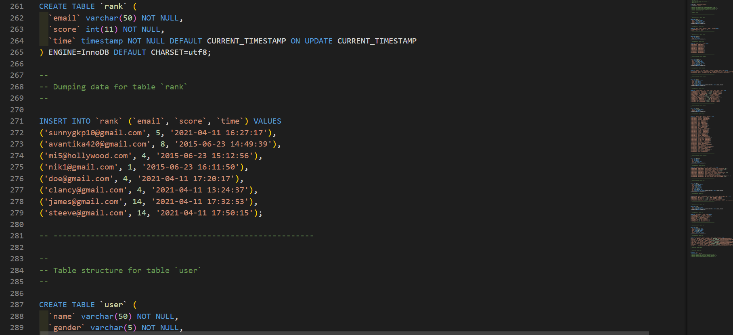

Slide 17
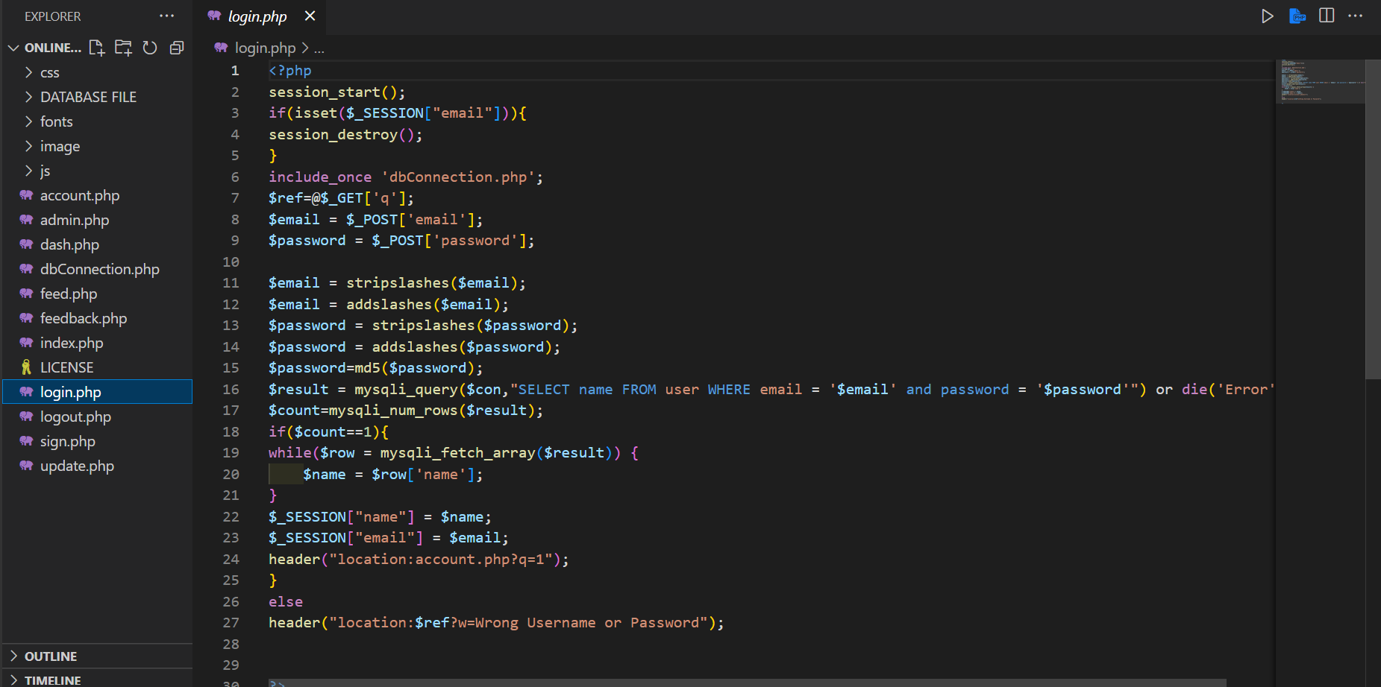
Coding and Testing

Slide 18
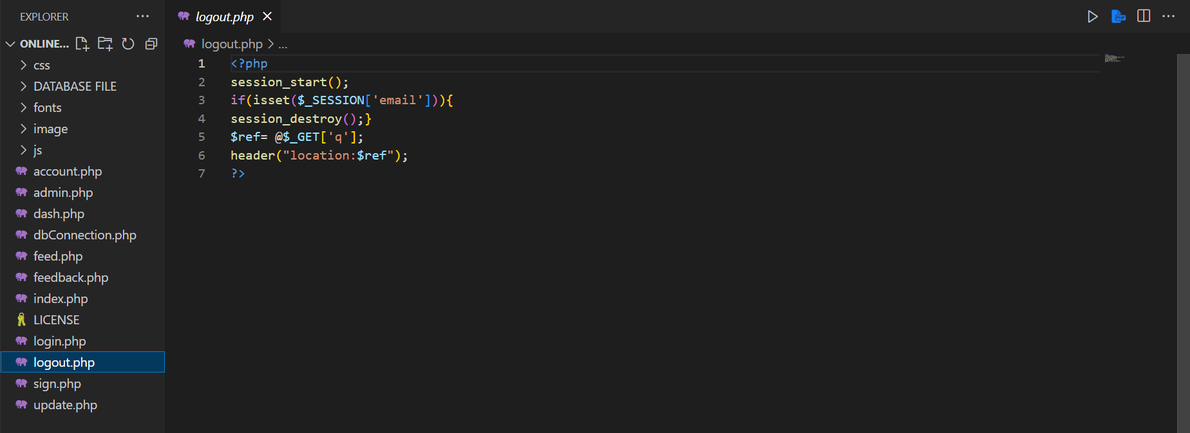
Login

Slide 19
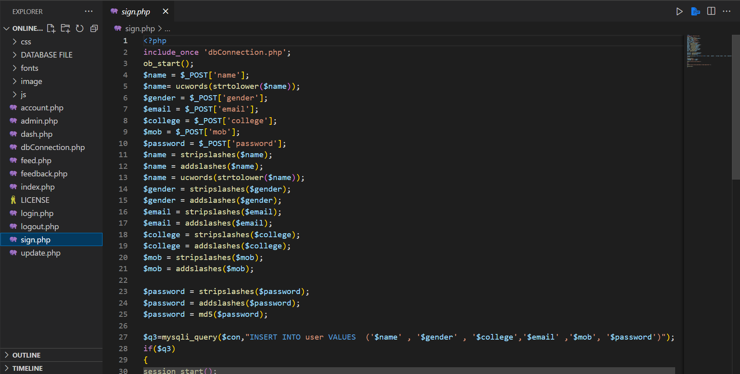
SignIn

Slide 20
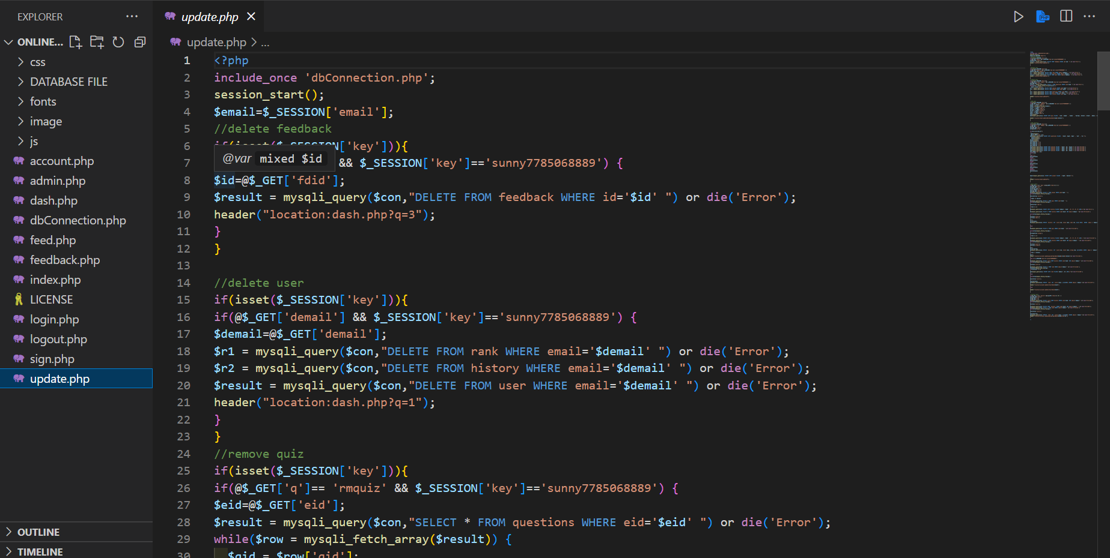
Updates

Slide 21
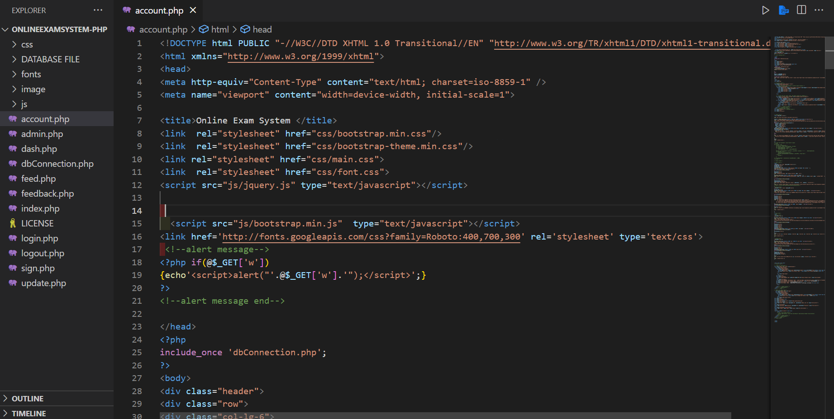
Accounts

Slide 22
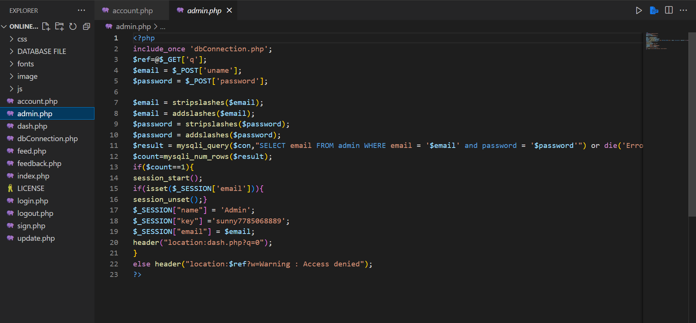
Admin

Slide 23
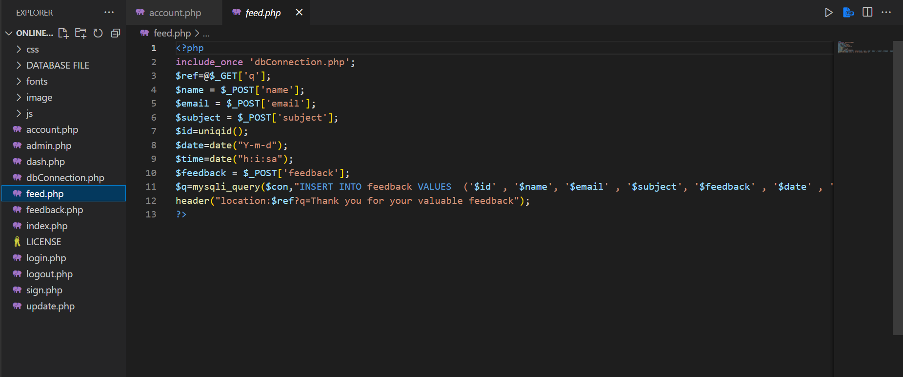
Feed

Slide 24
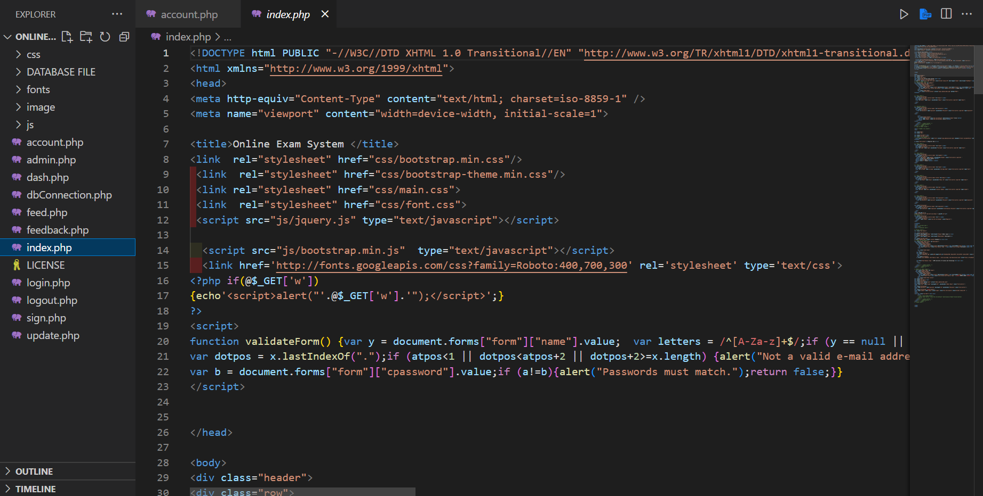
Index.php

Slide 25
Conclusion and Future Enhancement
In conclusion, an online examination system is a crucial tool for educational institutions and organizations to conduct exams and assessments in a secure, scalable, and user-friendly manner.
While the developed online examination system has met the requirements of educational institutions and organizations, there is always room for improvement. The following are some future enhancements that could be made to the system:
Integration with Learning Management Systems (LMS):
Integrating the online examination system with popular LMS platforms such as Moodle, Blackboard, or Canvas would provide a seamless and comprehensive educational experience for students.
The integration of Artificial Intelligence (AI) in the online examination system could improve the system's ability to tailor the exam questions to the student's knowledge level, providing a personalized and engaging exam experience.

Slide 26
References
[1]Hernández, E.; Sanchez-Anguix, V.; Julian, V.; Palanca, J.; Duque, N. Rainfall prediction: A deep learningapproach. In International Conference on Hybrid Artificial Intelligence Systems; Springer: Cham, Switzerland,2016; pp. 151–162.
[2]Goswami, B.N. The challenge of weather prediction. Resonance 1996, 1, 8–17.
[3]Nayak, D.R.; Mahapatra, A.; Mishra, P. A survey on rainfall prediction using artificial neural network. Int. J.Comput. Appl. 2013, 72, 16.
[4]Kashiwao, T.; Nakayama, K.; Ando, S.; Ikeda, K.; Lee, M.; Bahadori, A. A neural network- based localrainfall prediction system using meteorological data on the internet: A case study using data from the Japanmeteorological agency. Appl. Soft Comput. 2017, 56, 317–330.
[5]Mislan, H.; Hardwinarto, S.; Sumaryono, M.A. Rainfall monthly prediction based on artificial neural network:A case study in Tenggarong Station, East Kalimantan, Indonesia. Procedia Comput. Sci. 2015, 59, 142–151.
[6]Muka, Z.; Maraj, E.; Kuka, S. Rainfall prediction using fuzzy logic. Int. J. Innov. Sci. Eng. Technol. 2017, 4, 1–5.

